Slide 1

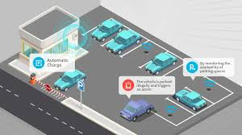
Car Parking System
Submitted by: Aryan Sharma(12220735)
Ashis Pradhan(12220083)
Alok Gupta(12220300)
PSV Ganesh(12220402)
Submitted to: Mohammad Asif Ikbal (22797)

Slide 2
Abstract
A car parking system is an automated solution designed to manage and optimize the use of parking spaces in various facilities. It typically employs sensors, microProcessor, and infrared communication to monitor the availability of parking slots in real-time. This system aims to reduce traffic congestion in parking areas by providing clear information about vacant slots, thereby streamlining the parking process. By integrating a display at the entrance, users can easily identify open parking slots, minimizing the need for manual assistance and reducing time spent on searching for a parking spot. Overall, a car parking system enhances efficiency, saves time, and contributes to better parking management in commercial and industrial settings.

Slide 3
Introduction
This Car Parking System is a simple system that allows users to park and retrieve their cars from a parking lot. The system will keep track of the available spots and the spots occupied by parked cars. This system will improve the management of parking spaces and make it more efficient for users to find a parking
spot.

Slide 4
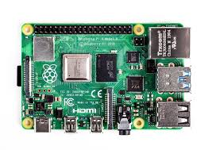
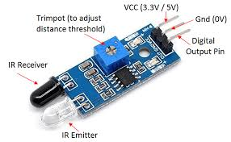
Componets
A. Raspberry pi
A powerful feature of the Raspberry Pi is the row of GPIO (general-purpose input/output) pins along the top edge of the board. A 40-pin GPIO header is found on all current Raspberry Pi boards, although it is unpopulated on Raspberry Pi Zero, Raspberry Pi Zero W, and Raspberry Pi Zero 2 W. The GPIO headers on all boards have a 0.1in (2.54mm) pin pitch. It is also known as Mini CPU.
B. Infrared sensor
An infrared sensor is a device that detects infrared radiation in its environment and outputs an electric signal. this sensor can detect movement as well as to measure the heat of an object. This sensor can detect infrared radiation, which is invisible to our eyes.

Slide 5
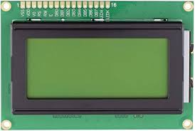
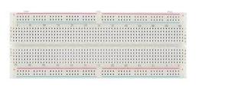
LCD
We utilize screen as display. LCD is utilized in a project to visualize the output of application. Liquid crystal displays (LCDs) have supplies which combine the properties of both liquids and crystals. With the liquid crystal material sand witched in between them, an LCD consists of two glass panels. The inner surface of the glass plates are covered with transparent electrodes that identify the character, symbols or patterns to be displayed and the polymeric layers are present in between the electrodes and the liquid crystal, which makes the liquid crystal molecules for maintaining a defined direction angle.
Bread Board
A breadboard (sometimes called plugblock) is used for building temporary circuits. It is useful to designers because it allows components to be removed and replaced easily.
It is useful to the person who wants to build a circuit to demonstrate its action, then to reuse the components in another circuit.

Slide 6


Software Requirement
Proteus 8
Proteus 8 is a proprietary software tool suite used primarily for electronic design automation. It is developed by Labcenter Electronics Ltd and is available in multiple languages. Proteus 8 is used mainly by electronic design engineers and technicians to create schematics and electronic prints for manufacturing printed circuit boards. It offers features such as schematic capture, simulation, and PCB layout design. All PCB Design products include an autorouter and basic mixed mode SPICE simulation capabilities. The software supports co-simulation of various microcontrollers, including Arduino and Raspberry Pi. Proteus 8 also includes a 3D viewer for visualizing the board under development.
MQTT
MQTT is a standards-based messaging protocol, or set of rules, used for machine-to-machine communication. Smart sensors, wearables, and other Internet of Things (IoT) devices typically have to transmit and receive data over a resource-constrained network with limited bandwidth.

Slide 7
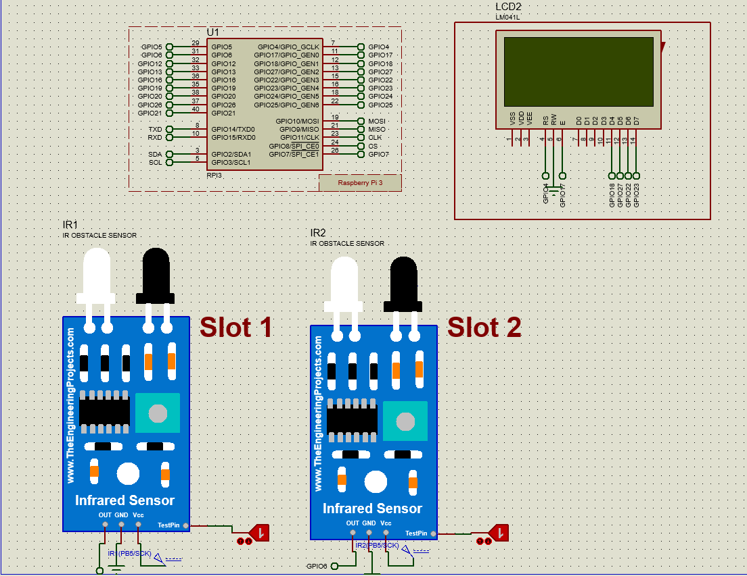
Proteus Diagram

Slide 8
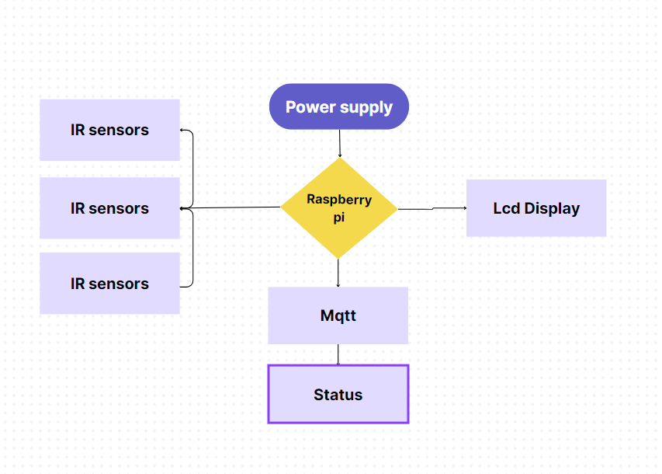
Flow Chart
Working
The proposed method consists of power supply, IR senors, LCD module, Rapberry pi and mobile application.
We will give them external power supply,
Due to that all functions of equipment's are ON.
Upload the program in raspberry pi.
IR sensor detect the presence of vehicle and display will show the Output.
At that time, we will pass the notice/Message which we want using mobile.

Slide 9
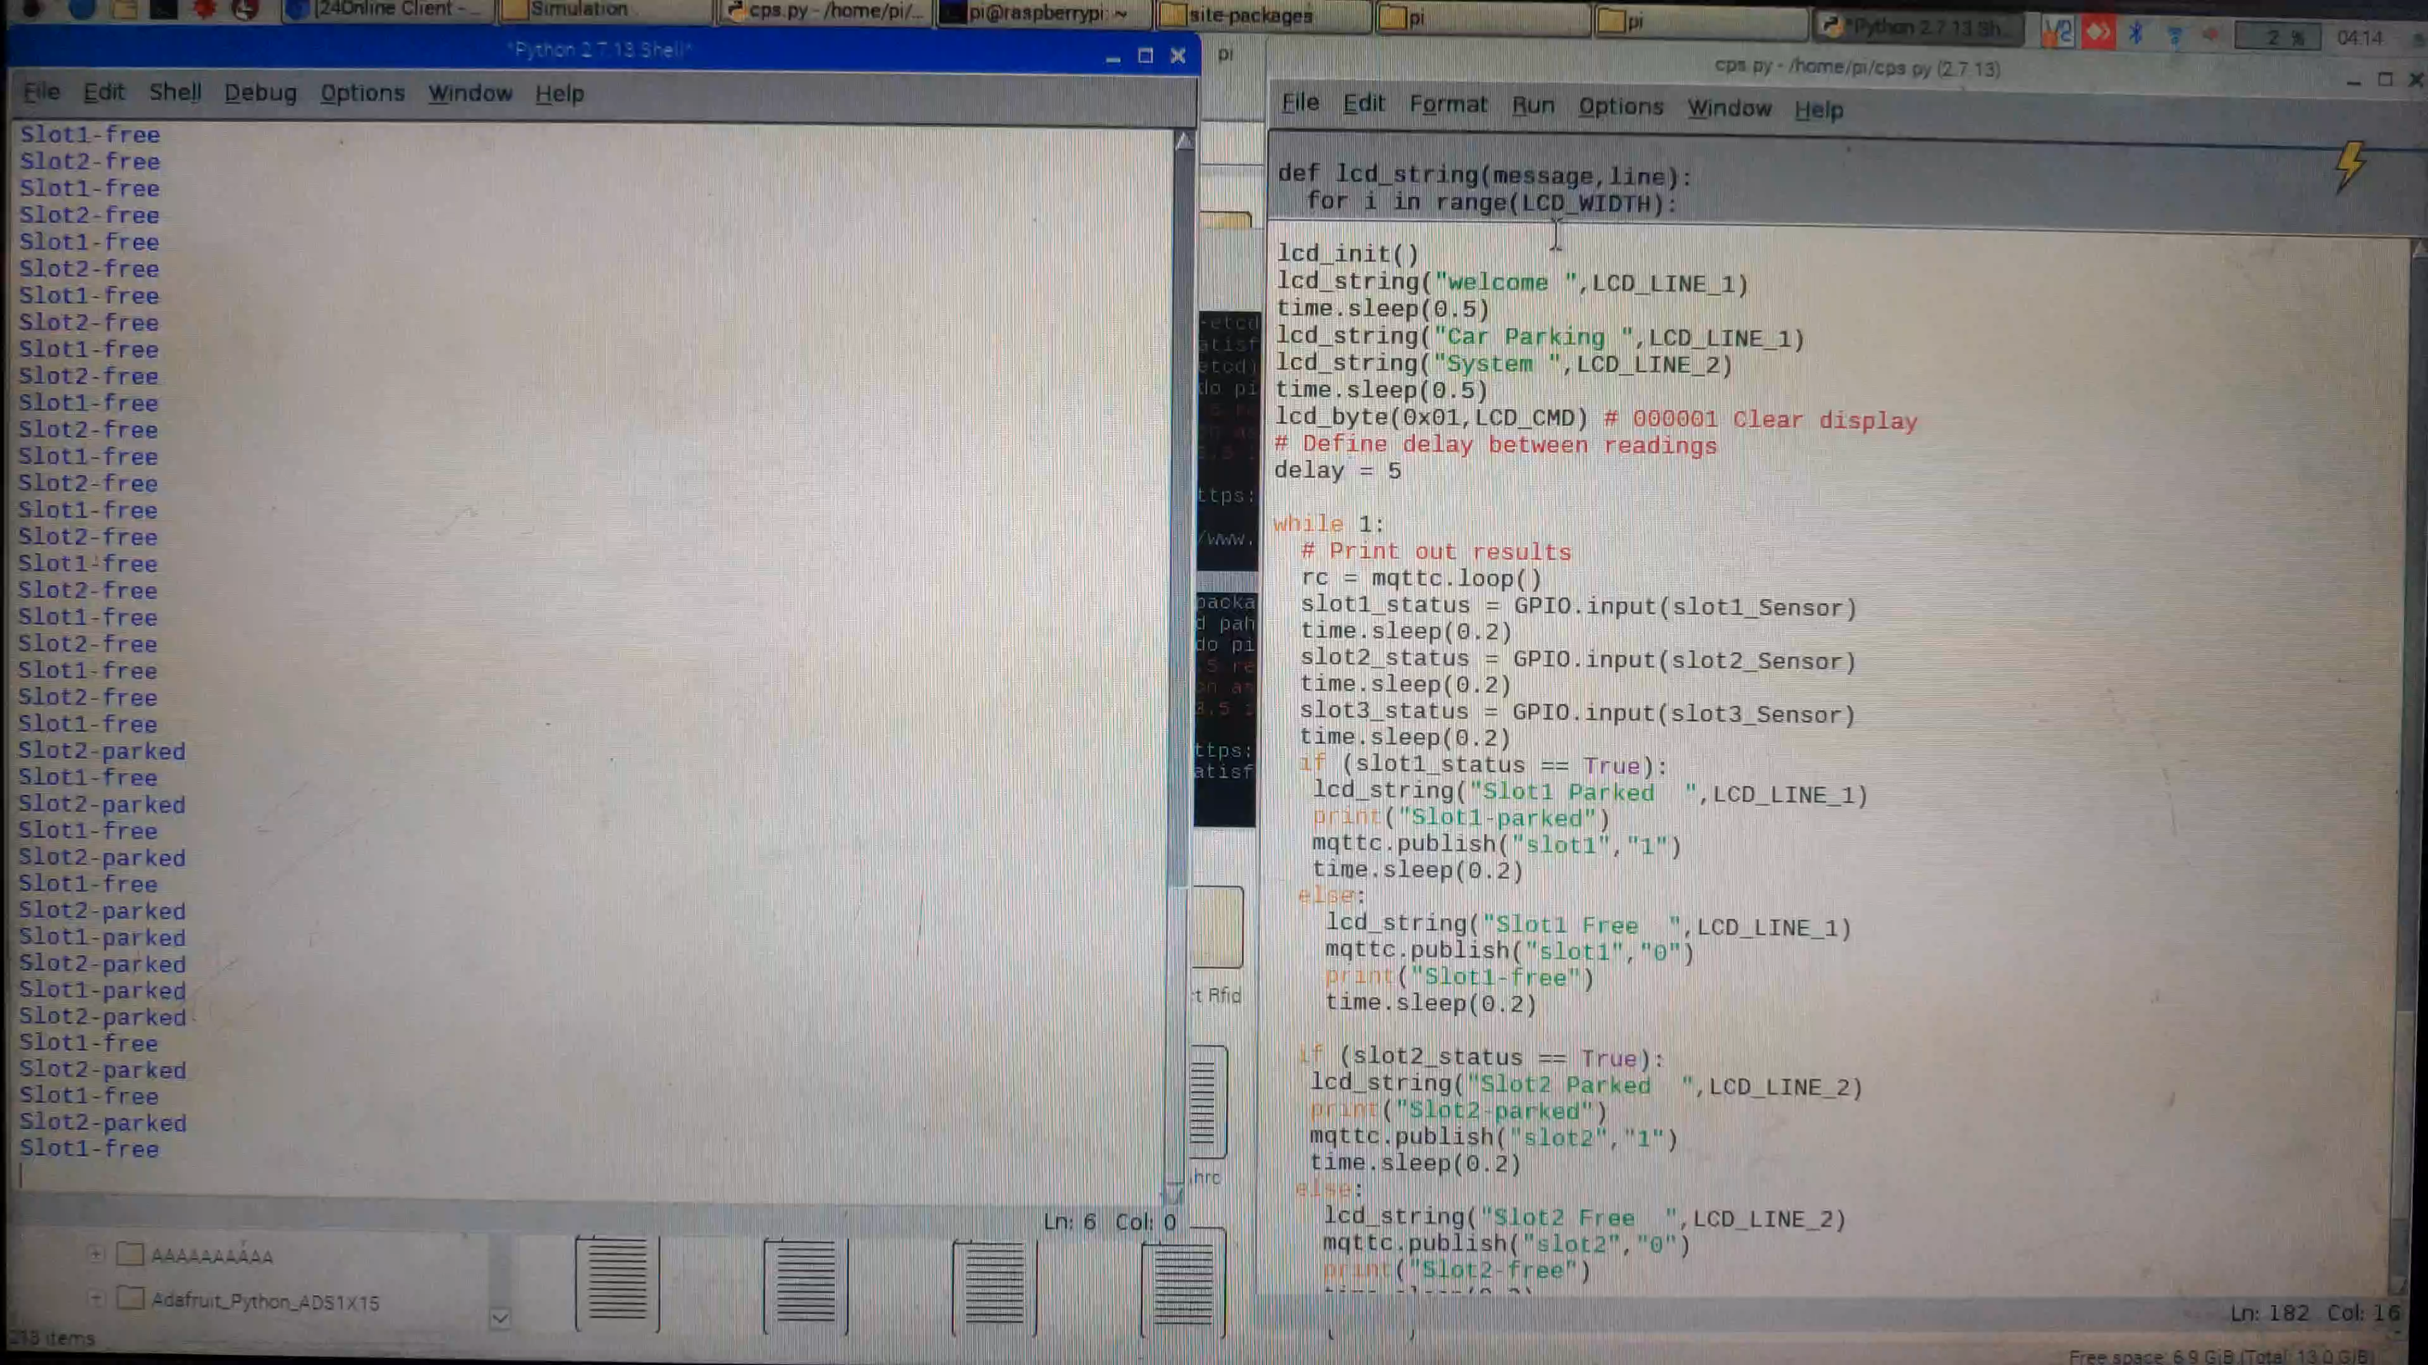
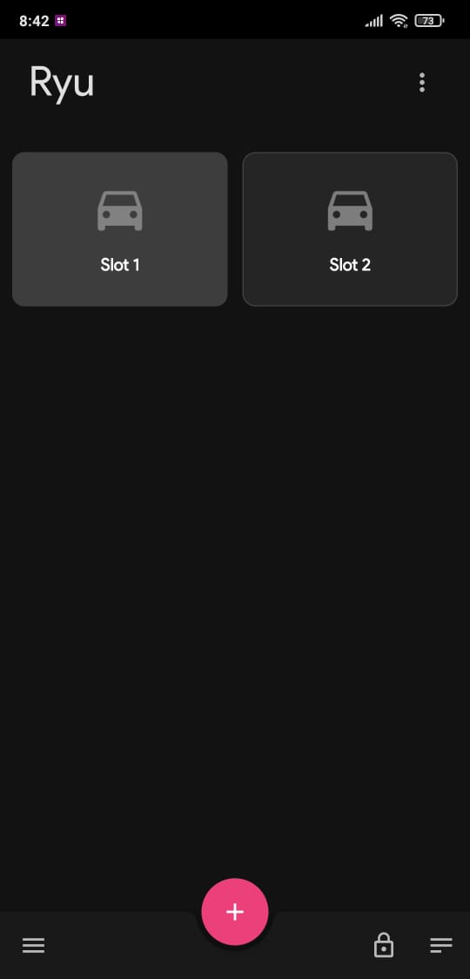
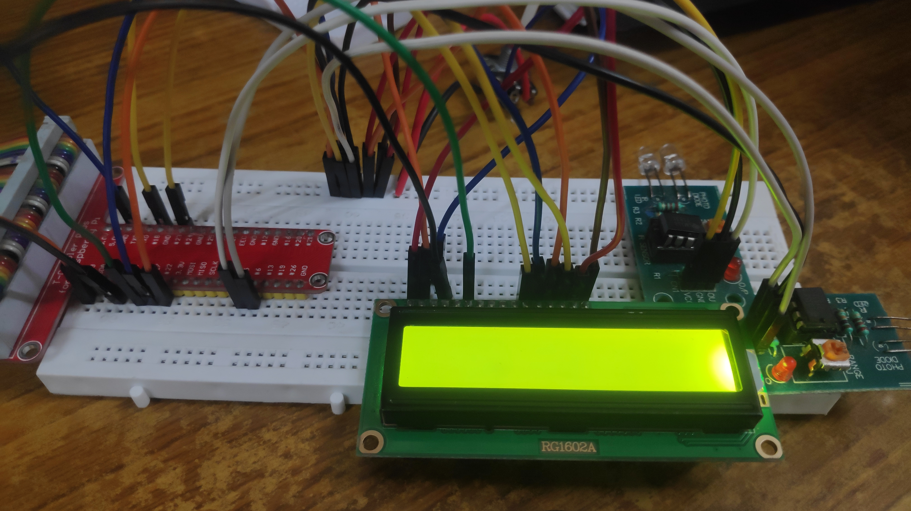
I/O Video

Slide 10
Result
Efficient space utilization: The system should effectively allocate parking spaces, maximizing the use of available space.
Reduced congestion: By guiding drivers to available parking spots, the system can help
reduce congestion and traffic flow within parking areas.
Improved customer experience: Users should find it easier and quicker to locate parking
spaces, enhancing their overall satisfaction.
Increased revenue: For commercial parking facilities, an effective parking system can lead to increased revenue through improved efficiency and potentially higher utilization rates.
Enhanced security: Some parking systems include features such as surveillance cameras
and access control measures to enhance security for both vehicles and occupants.

Slide 11
Conclusion
In conclusion, a well-designed and properly implemented car parking system offers numerous benefits to both operators and users. It optimizes space utilization, reduces congestion, enhances the overall customer experience, potentially increases revenue, and improves security. By efficiently guiding drivers to available parking spots and incorporating advanced technologies such as sensors and automated payment systems, modern parking systems address the challenges of urban mobility and contribute to a more seamless and convenient transportation experience. As cities continue to grow and evolve, investing in smart parking solutions becomes increasingly essential for sustainable urban development and improved quality of life.

Slide 12
Thank You!
THE END
Entertainment Never die!

